Slide 1

BETH Hackathon: Bloodchain Daniel Trutmann Felix Crazzolara Holmfridur Thorsteinsdottir Irina Lafois Matteo Guscetti Roland Schwan Yousef Gharaibeh
Open Challenge

Slide 2



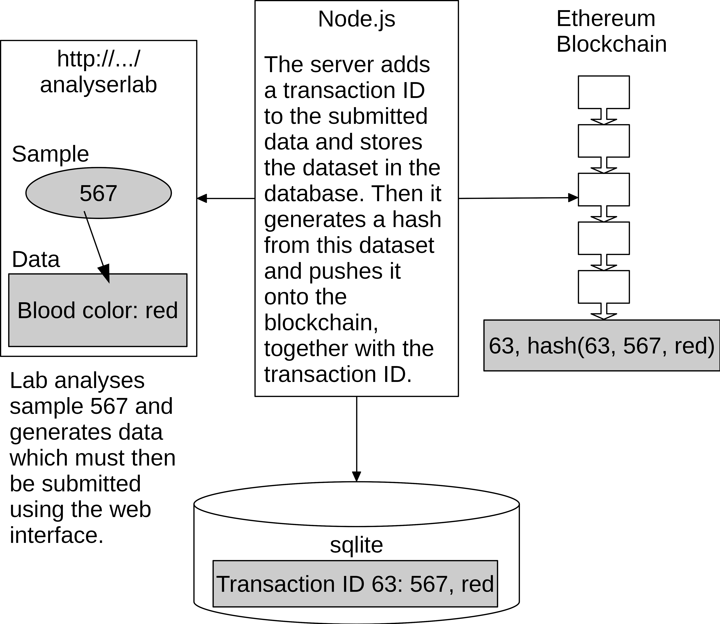


Challenges & Opportunities in Clinical Sample Management
Example: Analysis Laboratory
?
Information Flow
Information Flow
Central Lab
Central Lab
Clinical Site
Clinical Site
Central Lab
Central Lab
Analysis Lab
Analysis Lab
Analysis Lab
Analysis Lab
Result Lab
Result Lab
Provides sample kits
Provides sample kits
Draws samples from patients
Draws samples from patients
Collects filled sample kits
Collects filled sample kits
Provides sample analysis
Provides sample analysis
Provides sample analysis
Provides sample analysis
Provides results
Provides results
Block #1
Block #2
Block #3
Block #4
Block #5
Block #6
Blockchain
Notes:
Your Project Idea: What is the (social, economic, environmental,…) challenge you want to solve? And what is your approach / solution?
------------------------------------------------------------------
Accurate & clean clinical trial data is needed to bring therapeutics to the patients who need them
However there are huge challenges, e.g.
The clinical sample management is largely manual
logistics challenges in sample tracking
Real-time access is not possible
Chain of custody is unclear
We propose a blockchain-based solution to address these challenges

Slide 3

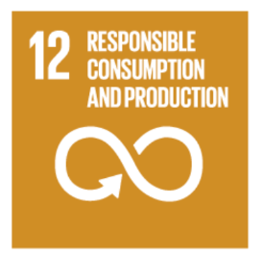
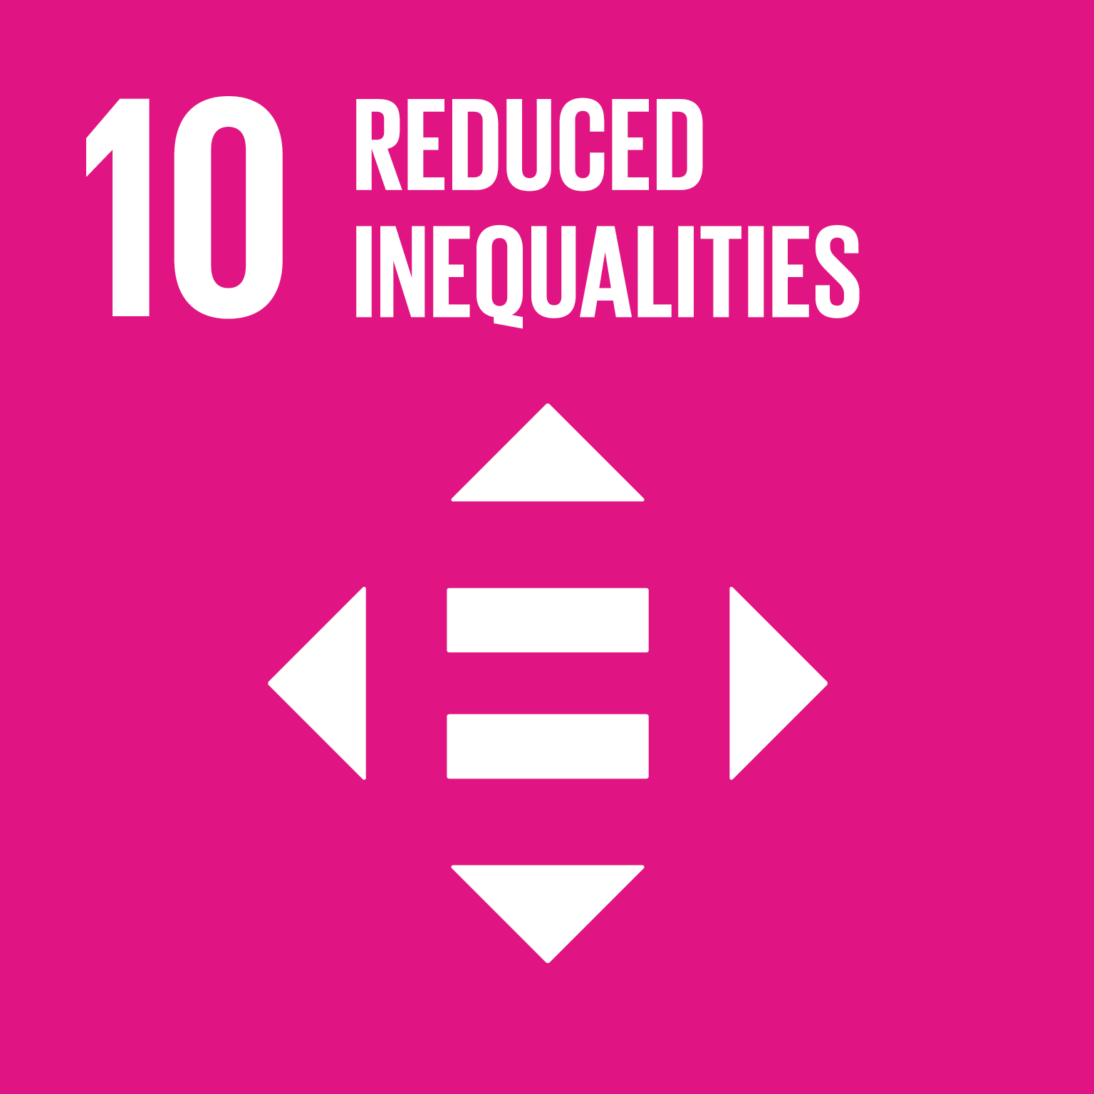

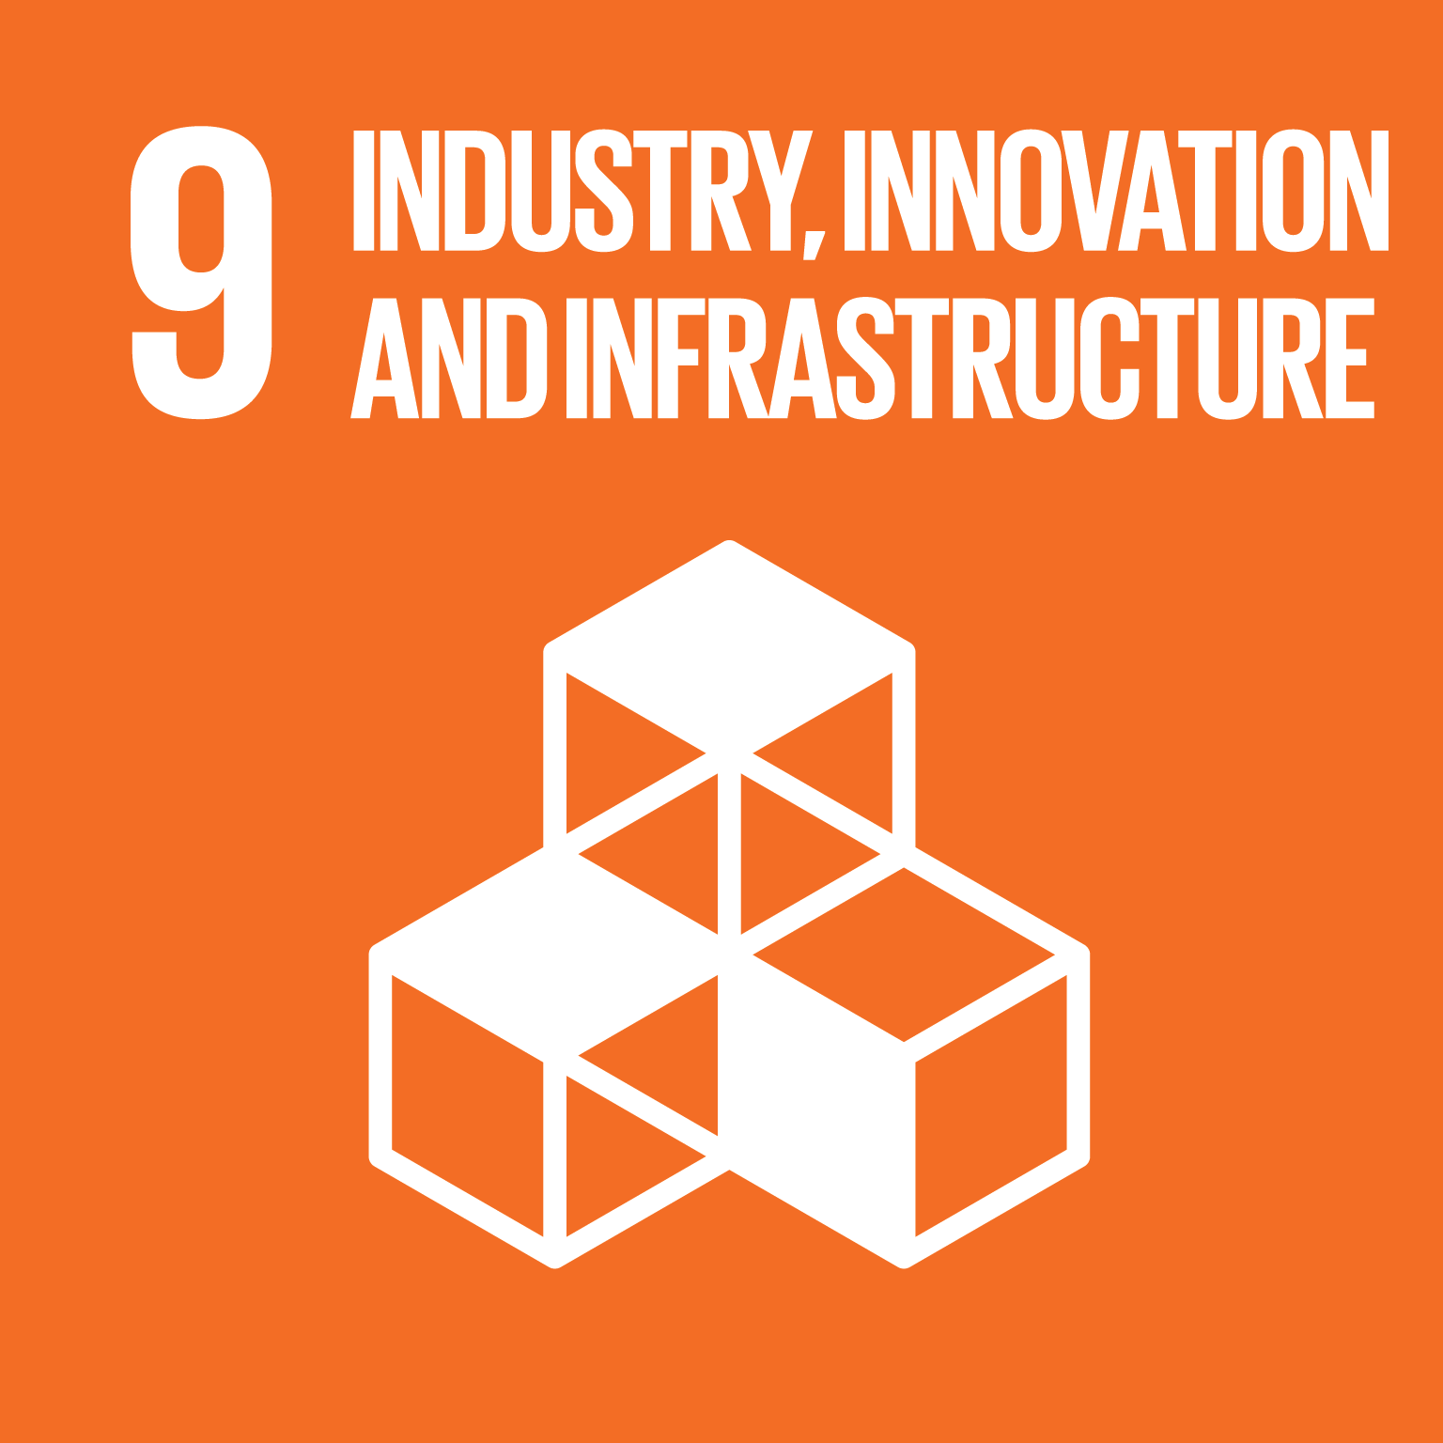
Solution: Benefit & Sustainability
Goal 1
Core service revolves around improving health and well-being
Goal 17
Goal 2
Goal 6
Goal 3
Goal 15
UN Sustainability
Pillars*
Goal 4
Goal 14
Goal 5
Sustainable consumption of medical sample and production patterns in order to develop the drug/treatment in a focused effective approach
Goal 13
Goal 6
Goal 12
Process simplification to encourage innovation, and economic growth
economical growth can be via cost effective process
Goal 7
Goal 11
Goal 8
Goal 10
Goal 9
Increases the investment for further innovation projects to improve health and well-being and reduce inequality globally
*https://sustainabledevelopment.un.org/?menu=1300
Notes:
Disruption Potential:
What is the outcome for society? What changes as compared to the status quo?
------------------------------------------------------------------------------------
Within the proposed bloodchain development, many sustainable goals set by the UN have been fulfilled or addressed.
For instance, naturally the core service is revolved around improving health and well-being (goal 3), yet, this development is considered as the first step to build a digital infrastructure for the future of the blockchain for medical application.
With the prospect of process simplification, it can encourage innovation, and economic growth (goal 8 and 9).
The economical growth can be via cost effective process, which consequently increases the investment for further innovation projects to improve health and well-being and reduce inequality globally (goal 10).
Furthermore, bloodchain development can lead to strengthen sustainable consumption of medical sample and production patterns in order to develop the drug/treatment in a focused effective approach (goal 12).

Slide 4
Achievements & Open Questions
Achievements
Open Questions & Challenges
Single Point of Truth
End-To-End Traceability
Data Safety
Ease of Use
Harmonizing & Streamlining Processes
Power to the Patients
Need to Align Regulatory Authorities
Lack of Resource Availabilities
Talent
Cost
etc…
High Initial Investment
Emerging Technology (hype vs fear)
Notes:
Difficulties You Experienced / Open Challenges
Where could you identify potential negative outcomes?
Which questions remain to be solved?
---------------------------------------------------------------
Blockchain is at its early stage of growth, there are many challenges that needs to address, yet, many to be identified first. This includes;
platform flexibility to accommodate diversity of designs,
legacy data,
balance between open and confidential information.
Furthermore, although security is a core feature of blockchain however, this is not entirely true, as there is interface blockchain and its’ users, where user personal key can be stolen and misused.
Furthermore, there are other barriers including; integration between legacy system and the blockchain, it requires
highly skilled personal that are limited in supply,
lack of regulation (consequently increases uncertainty) and
lack of legal enforcement w.r.t smart contractors,
high initial investment cost, negative perception and finally
emerging of multiple eco-system that might prevent from wide spread adoption.

Slide 5
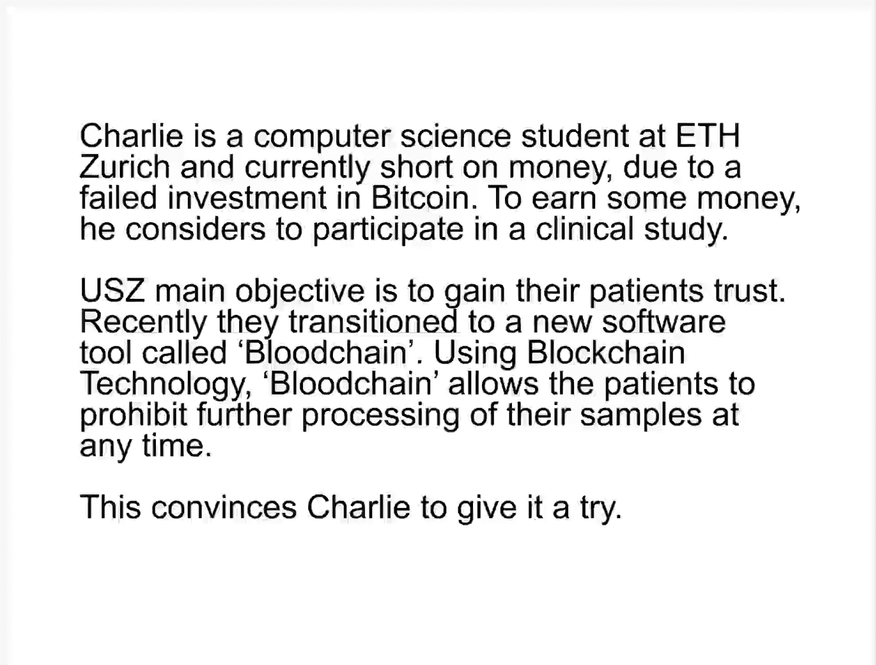
Software Demo
Notes:
If available, short software demo

